Slide 1
IBM University Engagement Project Submission
“Exploring the Power of Agentic AI with IBM Granite and IBM Bob”

Slide 2

Project Tile – [Smart Study Generator Agent]
Domain of Project – [ Education ]
Student Name | Recent Passport Photo | Email ID | Mobile number [WhatsApp]
CHINMAI AWATE |  | chinmai.awate25@mmit.edu.in | 8805525693
Recommended font style and size: Font Style: Arial Font Size (Heading): 28
Font Size (Content): 20

Slide 3
Problem Statement -
Problem Statement :Smart Study Generator Agent
The Challenge
Students today face an overwhelming flood of information-lecture notes, textbooks, research
papers, YouTube tutorials, and online resources. This content is scattered, unorganized, and
often not personalized to their learning pace or style. As a result, students struggle with finding
the right study material, summarizing key concepts, and staying exam-ready. Traditional study
tools only provide static notes or flashcards, failing to adapt dynamically to student needs. The
challenge is to move beyond static resources toward an intelligent, adaptive study companion..
The Objective
Build an agentic AI-powered Smart Study Generator that personalizes and streamlines learning
for students. The solution should:
* Fuse Learning Resources: Aggregate content from class notes, textbooks, research
articles, and online tutorials into structured, easy-to-digest study material.
* Enable Multimodal Input: Allow students to upload notes, voice queries, or images (e.g.,
textbook pages), and generate concise summaries, flashcards, or concept maps.
*Create a Predictive & Agentic Layer: Recommend personalized study plans, highlight
important topics based on syllabus or past exams, and provide predictive alerts (e.g., “Focus
on Topic X—frequently asked in exams”).
*Visualize Study Progress: Offer a real-time dashboard showing learning milestones,
weak areas, practice quizzes, and performance forecasts.

Slide 4
Proposed Solution -
Proposed Solution: AI-Powered Smart Study Generator Agent
The proposed solution is a multi-agent AI-powered Smart Study Generator Agent built using IBM Bob, IBM watsonx.ai, and Granite Models to provide personalized and intelligent learning support. The system helps students organize scattered study materials, generate concise notes, and prepare effectively for exams.
At its core, the solution uses a Retrieval-Augmented Generation (RAG) pipeline to retrieve content from lecture notes, textbooks, research papers, online tutorials, and previous-year question papers. The information is stored in a vector database, allowing Granite models to generate accurate summaries, flashcards, concept maps, and quizzes.
The system consists of four key agents:
Learning Resource Agent retrieves and summarizes study materials from multiple sources.
Study Planner Agent creates personalized study schedules based on the syllabus, learning pace, and exam dates.
Exam Intelligence Agent predicts important topics using syllabus analysis and previous-year papers while generating practice quizzes.
Progress Tracking Agent monitors learning progress, identifies weak areas, and provides personalized feedback.
A Streamlit or React dashboard displays study progress, quiz performance, learning milestones, and exam readiness. IBM Bob manages agent workflows, watsonx.ai provides AI deployment and embeddings, and Granite Models power summarization, reasoning, and personalized recommendations.
Overall, the solution acts as an intelligent study companion that helps students learn smarter, stay organized, and improve academic performance.

Slide 5
Technology Used
IBM Bob platform -For designing and orchestrating multi-agent workflows visually
IBM Granite model - for eg – ibm-granite-3-2-8b – For natural language understanding, reasoning, and personalization
IBM Cloud – It provides the infrastructure to build, deploy, and scale the Smart Study Generator Agent efficiently. IBM Cloud enables a reliable, secure, and scalable environment for deploying the Smart Study Generator Agent.
RAG– RAG to fetch real data first, then generate intelligent answers, making the Smart Study Generator Agent more trustworthy and effective.
IBM Watsonx.ai - For model deployment, embeddings, and AI governance
Vector Database (FAISS/Chroma) – For RAG-based Educational data retrieval

Slide 6
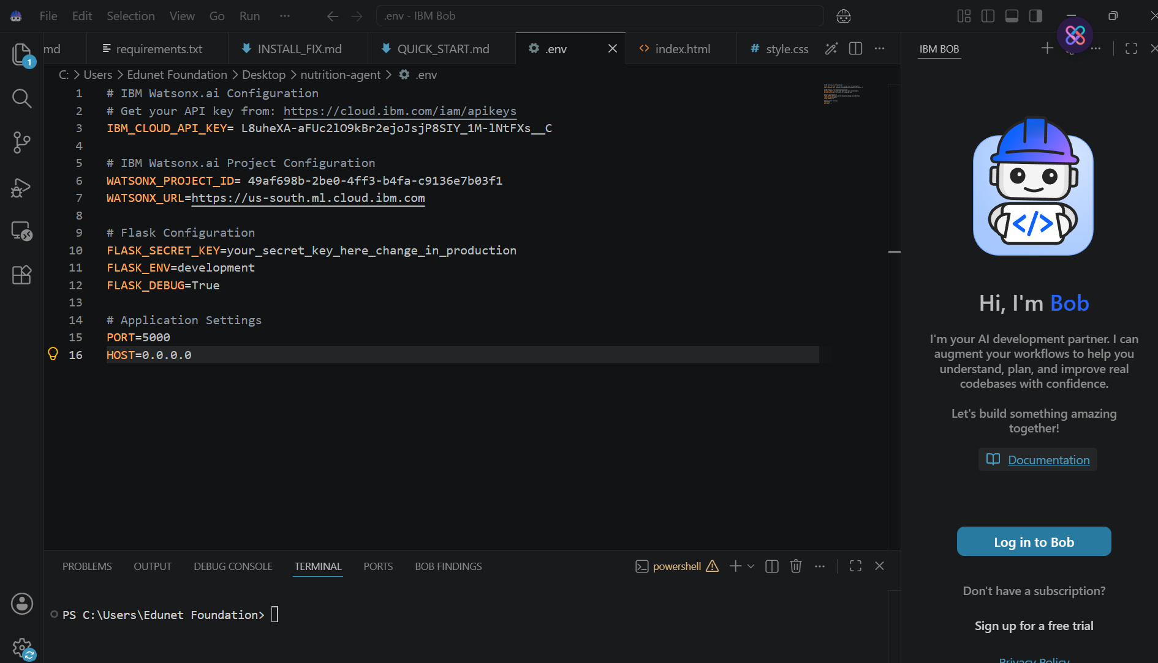
Required Files created using IBM bob -
Index.html

Slide 7
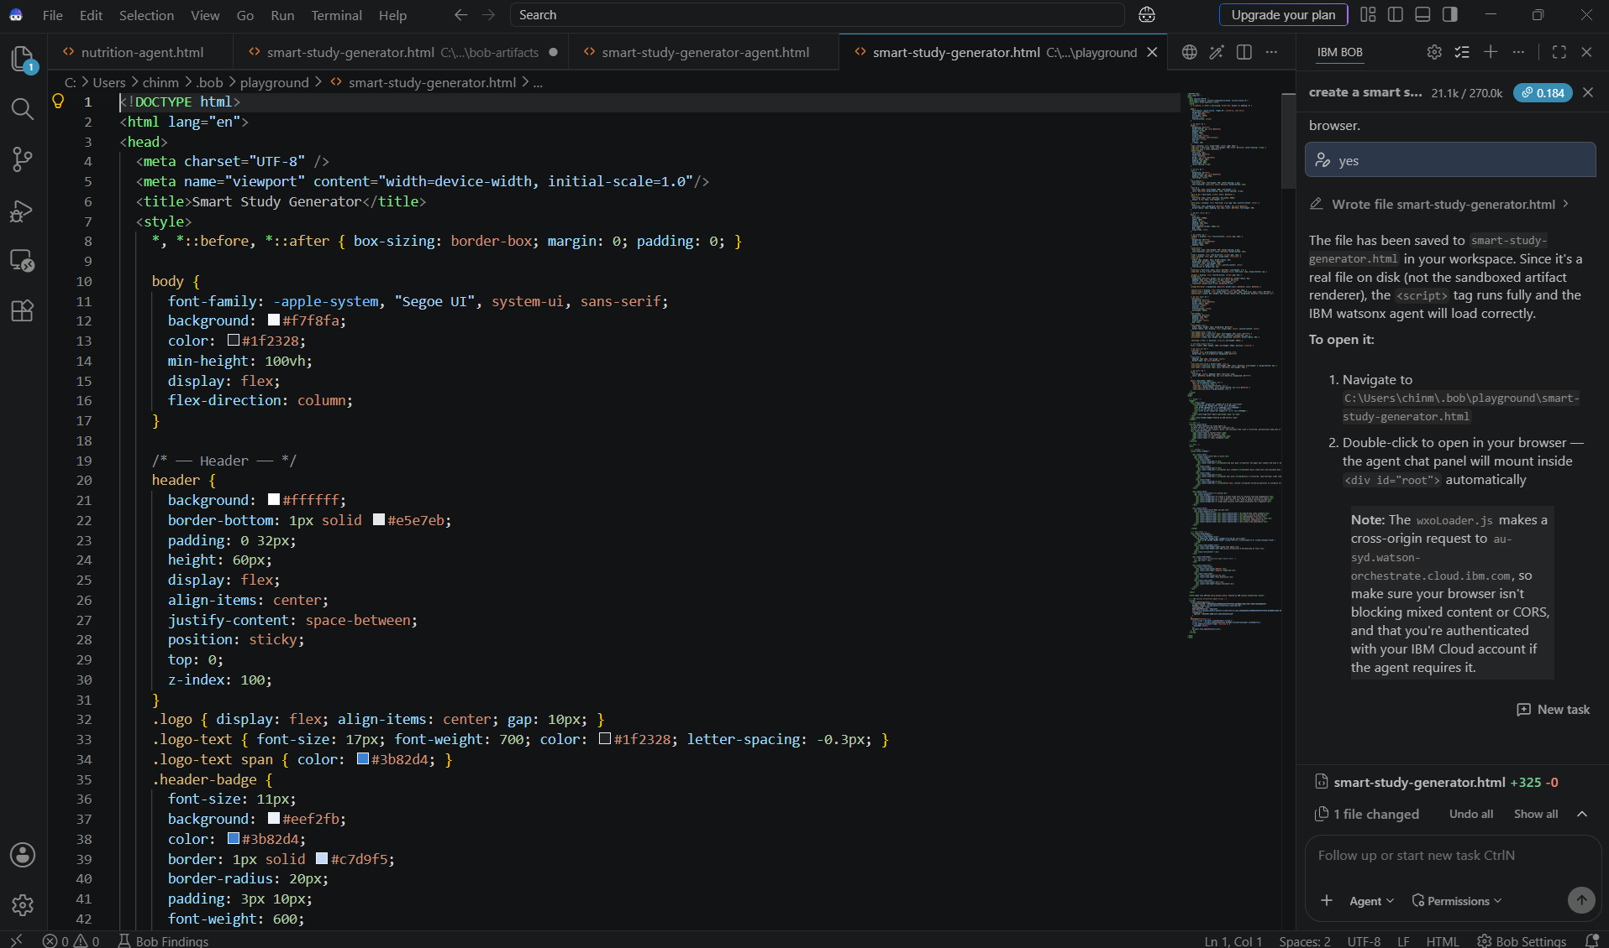
IBM Bob Screenshots:

Slide 8

Architecture blueprint for IBM bob:

Slide 9

Role of Agentic AI in the solution
Role of Agentic AI in Smart Study Generator Agent
Agentic AI enables the Smart Study Generator Agent to function as an intelligent, autonomous learning assistant rather than a simple study tool. Using IBM watsonx.ai and IBM Granite Models, it coordinates multiple specialized agents to provide personalized and adaptive learning support.
Each agent performs a specific role-such as retrieving study materials, generating summaries and flashcards, creating personalized study plans, predicting important exam topics, and tracking student progress-while working collaboratively. This multi-agent approach ensures efficient task execution and accurate learning outcomes.
Agentic AI also brings context awareness, understanding the student's syllabus, learning pace, strengths, weak areas, and exam schedule to generate personalized recommendations. It supports real-time adaptation, continuously updating study plans and learning resources based on user performance, quiz results, and new study materials.
Additionally, the agents communicate with each other, enabling better decision-making and a seamless learning experience.
Overall, Agentic AI makes the system proactive, personalized, and goal-driven, acting like a smart digital tutor that helps students organize their studies, improve understanding, and stay exam-ready.

Slide 10


Token Usage
11,761 token are used
Before Prompt
After the Prompt
·
·
·

Slide 11
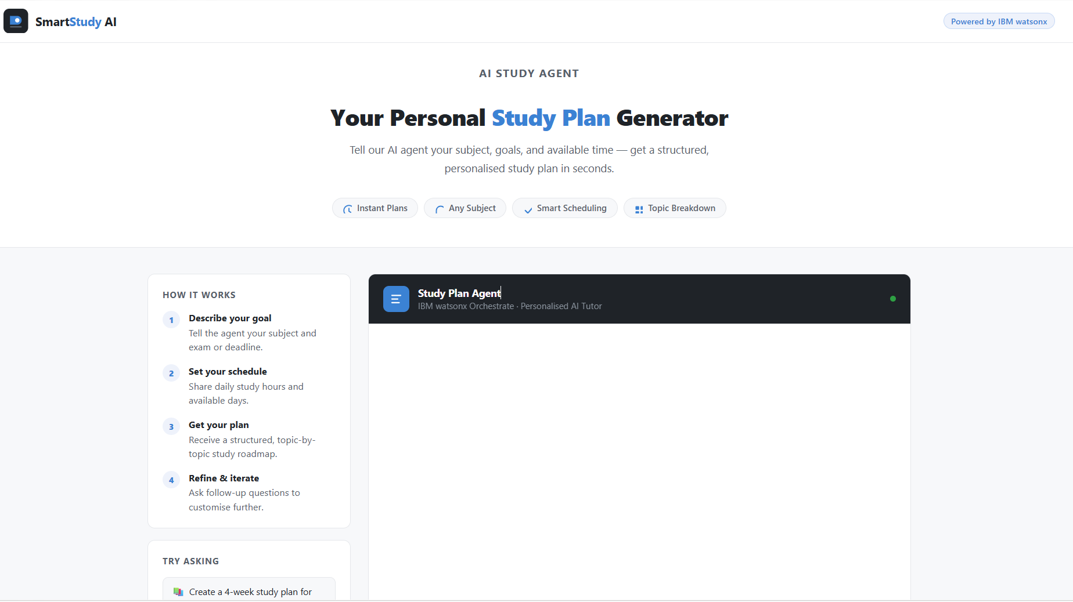
Project Output Screenshot
Please put IBM Bob output screenshots with 2-3 prompts.
You can take 2-3 more slides for each screenshot
·
·
·

Slide 12
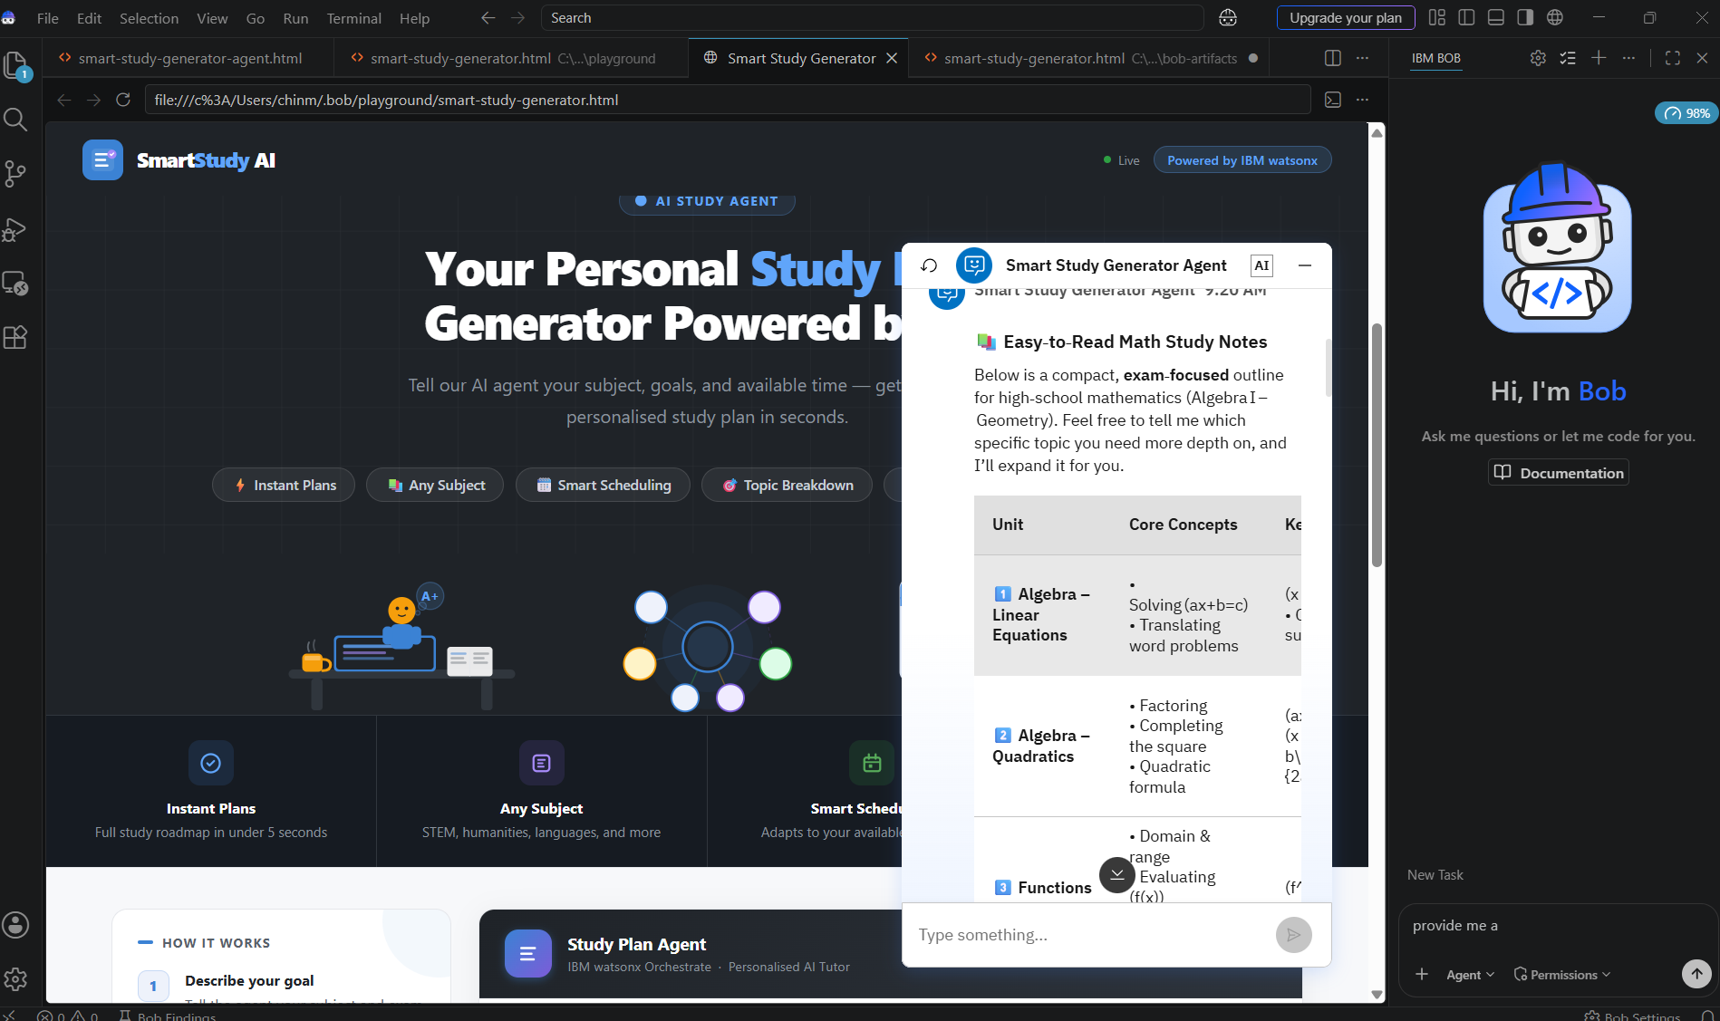
Project Output Screenshot
Please put IBM Bob output screenshots with 2-3 prompts.
You can take 2-3 more slides for each screenshot
·
·
·

Slide 13
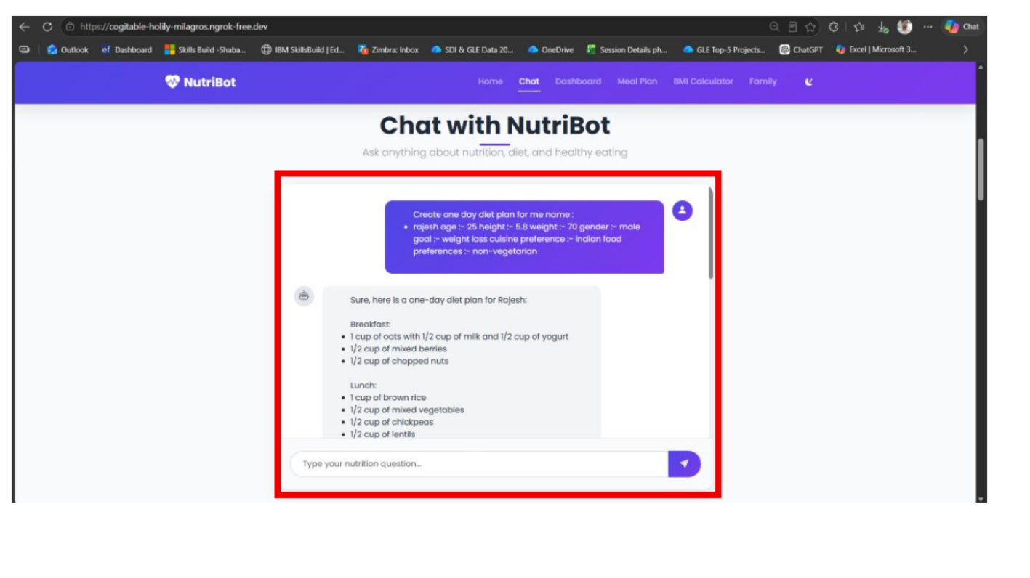
Project Output Screenshot
Please put IBM Bob output screenshots with 2-3 prompts.
You can take 2-3 more slides for each screenshot
·
·
·

Slide 14
Novelty and Uniqueness
Novelty and Uniqueness – Smart Study Generator Agent
The proposed Smart Study Generator Agent combines Agentic AI, Retrieval-Augmented Generation (RAG), and personalized learning to create an intelligent and adaptive study companion for students.
Multi-Agent Intelligence – Multiple specialized AI agents collaborate to summarize content, generate quizzes, create study plans, answer doubts, and track learning progress instead of relying on a single chatbot.
RAG-Based Learning – Retrieves information directly from uploaded study materials (PDFs, notes, PPTs, and textbooks) to generate accurate, context-aware, and reliable study resources.
Personalized Study Experience – Adapts study plans, explanations, and practice questions based on the student's learning pace, academic level, and exam schedule.
Automated Study Resource Generation – Instantly converts lengthy study materials into summaries, revision notes, flashcards, mind maps, and mock tests, reducing manual effort.
Adaptive Learning Feedback – Continuously analyses quiz performance and learning progress to recommend revision topics and improve weak areas.
Multi-Modal Learning Support – Supports text, PDF, document, and image-based study materials, making it easy for students to learn from different resource formats.
Exam-Oriented Intelligence – Prioritizes important concepts, predicts likely exam questions, and generates personalized revision strategies for efficient preparation.
Scalable & Enterprise-Ready – Built on IBM watsonx.ai with IBM Granite models, ensuring secure, reliable, and scalable AI-powered educational assistance.
This makes the Smart Study Generator Agent an intelligent, personalized, and proactive learning assistant that goes beyond static note-taking tools by autonomously organizing study materials, adapting to individual learning needs, and helping students prepare effectively for exams.

Slide 15
Git Hub Link
· Please create public github repository (Enable Add README button while creating repository) with format –
Please test and Paste the working Github URL –
Make sure you have Uploaded following three files into your github repository 1) All Agent relevant files of IBM Cloud , 2) yourproblemstatement.pdf file 3) your projectpresntation.pptx file 4)any other files
·
·
·

Slide 16
Future Scope
Future Scope – Smart Study Generator Agent
1. Integration with Learning Management Systems (LMS) The Smart Study Generator Agent can be integrated with platforms such as Google Classroom, Moodle, Canvas, and Microsoft Teams to automatically access course materials, assignments, and deadlines. This will enable the agent to generate personalized study plans and reminders based on the student's academic schedule.
2. AI-Powered Voice Tutor & Multilingual Support The system can be enhanced with a voice-enabled AI tutor and multilingual support, allowing students to interact naturally through speech and receive explanations in their preferred language. This will improve accessibility and make learning more inclusive for students from diverse linguistic backgrounds.
·
·
·

Slide 17
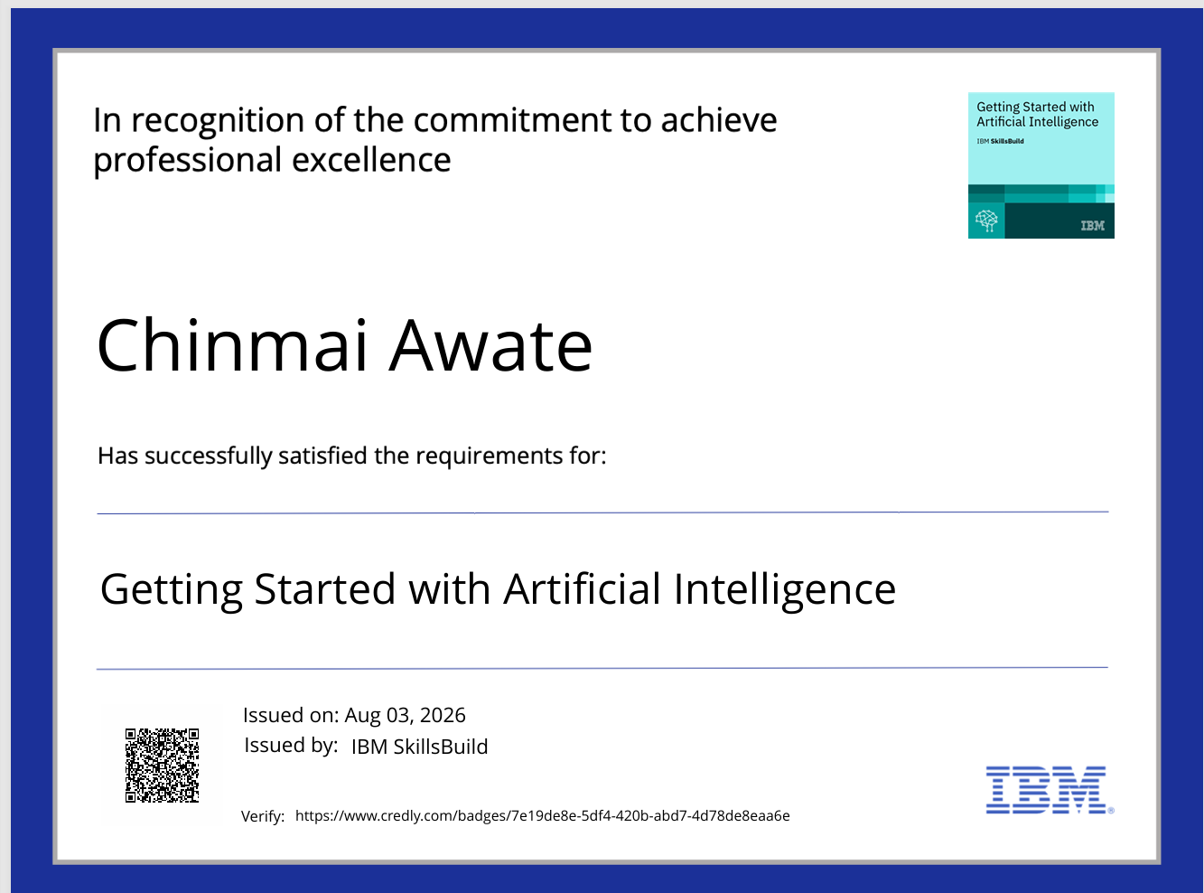
Certificates Earned:
Please add your credly certificate

Slide 18
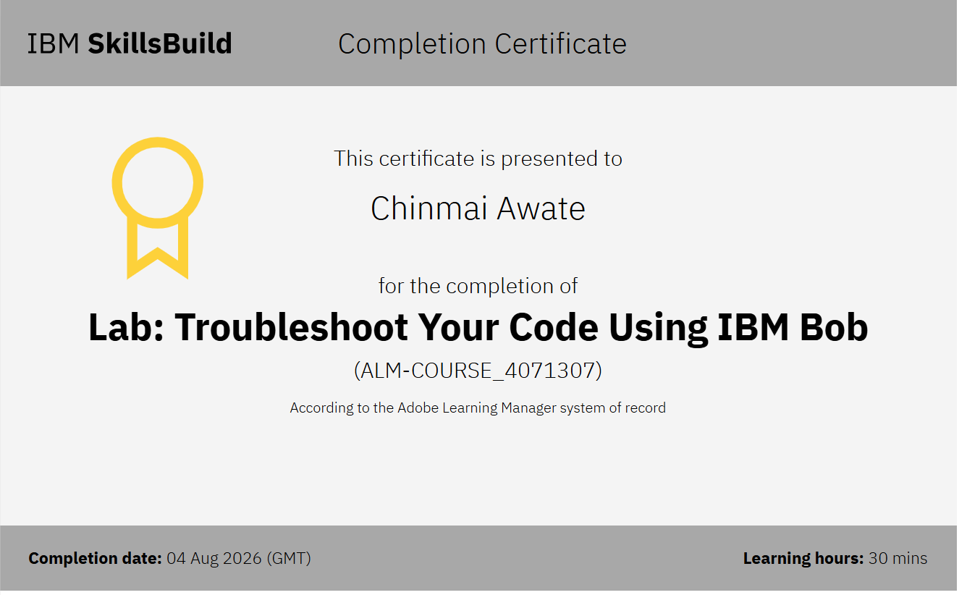
Certificates Earned:​
Add your IBM BOB Certificate

Slide 19


